Slide 1
BigData and Hadoop
Do IT yourself -> The Practical way

Slide 2
Giving some thought
Has your flight ever been cancelled due to bad weather conditions?
Can aeroplane catastrophic engine failures be prevented?
Have you ever missed out on buying something during a sale and wished the store or the department would have kept more quantity?
Have you ever wished political campaigns can be better targeted using social media data?
Do you wish your banking services to be more secure and fraud tolerant?
Today data is everything, each appliance we use in whatever sector produce huge volumes of data. Now this data is like an open oil field waiting to be tapped.

Slide 3
The BigData era…
Social media has brought about a revolution and dictated a paradigm shift in the operational strategies of firms globally.
It has resulted in collection of massive data from a variety of social media channels, necessitating use of this data for business intelligence purposes.
Despite its importance, little research exists on the implications of the use of Big Data analytics for business intelligence purposes.

Slide 4
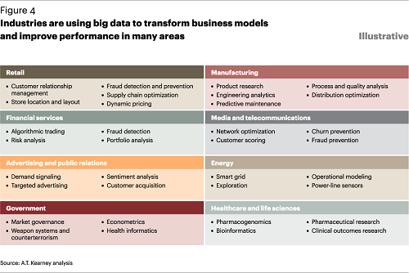
Major industrial impact

Slide 5
Distributed computing
Distributed computing is a computing concept that, in its most general sense, refers to multiple computer systems working on a single problem.
In distributed computing, a single problem is divided into many parts, and each part is solved by different computers.
As long as the computers are networked, they can communicate with each other to solve the problem. If done properly, the computers perform like a single entity.
The ultimate goal of distributed computing is to maximize performance by connecting users and IT resources in a cost-effective, transparent and reliable manner.
It also ensures fault tolerance and enables resource accessibility in the event that one of the components fails.

Slide 6
The breakthrough - Hadoop
Apache Hadoop is a collection of open-source software utilities that facilitate using a network of many computers to solve problems involving massive amounts of data and computation.
It provides a software framework for distributed storage and processing of big data using the MapReduce programming model.
Originally designed for computer clusters built from commodity hardware—still the common use—it has also found use on clusters of higher-end hardware.
All the modules in Hadoop are designed with a fundamental assumption that hardware failures are common occurrences and should be automatically handled by the framework.

Slide 7
Hadoop Architecture
Hadoop Common – contains libraries and utilities needed by other Hadoop modules
Hadoop Distributed File System (HDFS) – a distributed file-system that stores data on commodity machines, providing very high aggregate bandwidth across the cluster
Hadoop YARN – introduced in 2012 is a platform responsible for managing computing resources in clusters and using them for scheduling users' applications
Hadoop MapReduce – an implementation of the MapReduce programming model for large-scale data processing
Hadoop splits files into large blocks and distributes them across nodes in a cluster. It then transfers packaged code into nodes to process the data in parallel.
This approach takes advantage of data locality,where nodes manipulate the data they have access to. This allows the dataset to be processed faster and more efficiently.

Slide 8
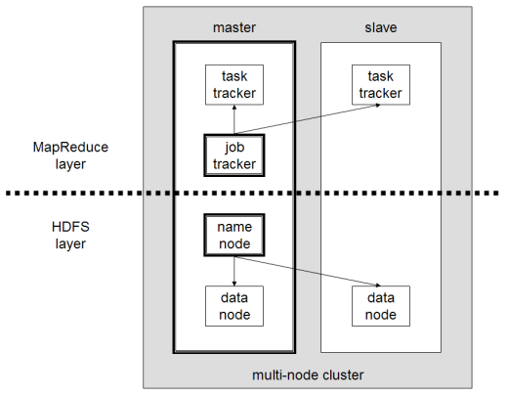
The architecture cont...

Slide 9
File System : HDFS
The Hadoop distributed file system is a distributed, scalable, and portable file system written in Java for the Hadoop framework.
A Hadoop cluster has nominally a single namenode plus a cluster of datanodes, although redundancy options are available for the namenode due to its criticality.
Each datanode serves up blocks of data over the network using a block protocol specific to HDFS. The file system uses TCP/IP sockets for communication. Clients use remote procedure calls (RPC) to communicate with each other.
It achieves reliability by replicating the data across multiple hosts, and hence theoretically does not require redundant array of independent disks (RAID) storage on hosts (but to increase input-output (I/O) performance some RAID configurations are still useful).
With the default replication value, 3, data is stored on three nodes: two on the same rack, and one on a different rack. Data nodes can talk to each other to rebalance data, to move copies around, and to keep the replication of data high.

Slide 10
Job Tracker & Task Tracker- The map-reduce engine
Atop the file systems comes the MapReduce Engine, which consists of one JobTracker, to which client applications submit MapReduce jobs.
The JobTracker pushes work to available TaskTracker nodes in the cluster, striving to keep the work as close to the data as possible.
With a rack-aware file system, the JobTracker knows which node contains the data, and which other machines are nearby.
If the work cannot be hosted on the actual node where the data resides, priority is given to nodes in the same rack.
This reduces network traffic on the main backbone network. If a TaskTracker fails or times out, that part of the job is rescheduled

Slide 11
The map-reduce engine cont...
The TaskTracker on each node spawns a separate Java virtual machine (JVM) process to prevent the TaskTracker itself from failing if the running job crashes its JVM.
A heartbeat is sent from the TaskTracker to the JobTracker every few minutes to check its status.
The allocation of work to TaskTrackers is very simple. Every TaskTracker has a number of available slots (such as "4 slots"). Every active map or reduce task takes up one slot.
The Job Tracker allocates work to the tracker nearest to the data with an available slot. There is no consideration of the current system load of the allocated machine, and hence its actual availability.
If one TaskTracker is very slow, it can delay the entire MapReduce job – especially towards the end, when everything can end up waiting for the slowest task.

Slide 12
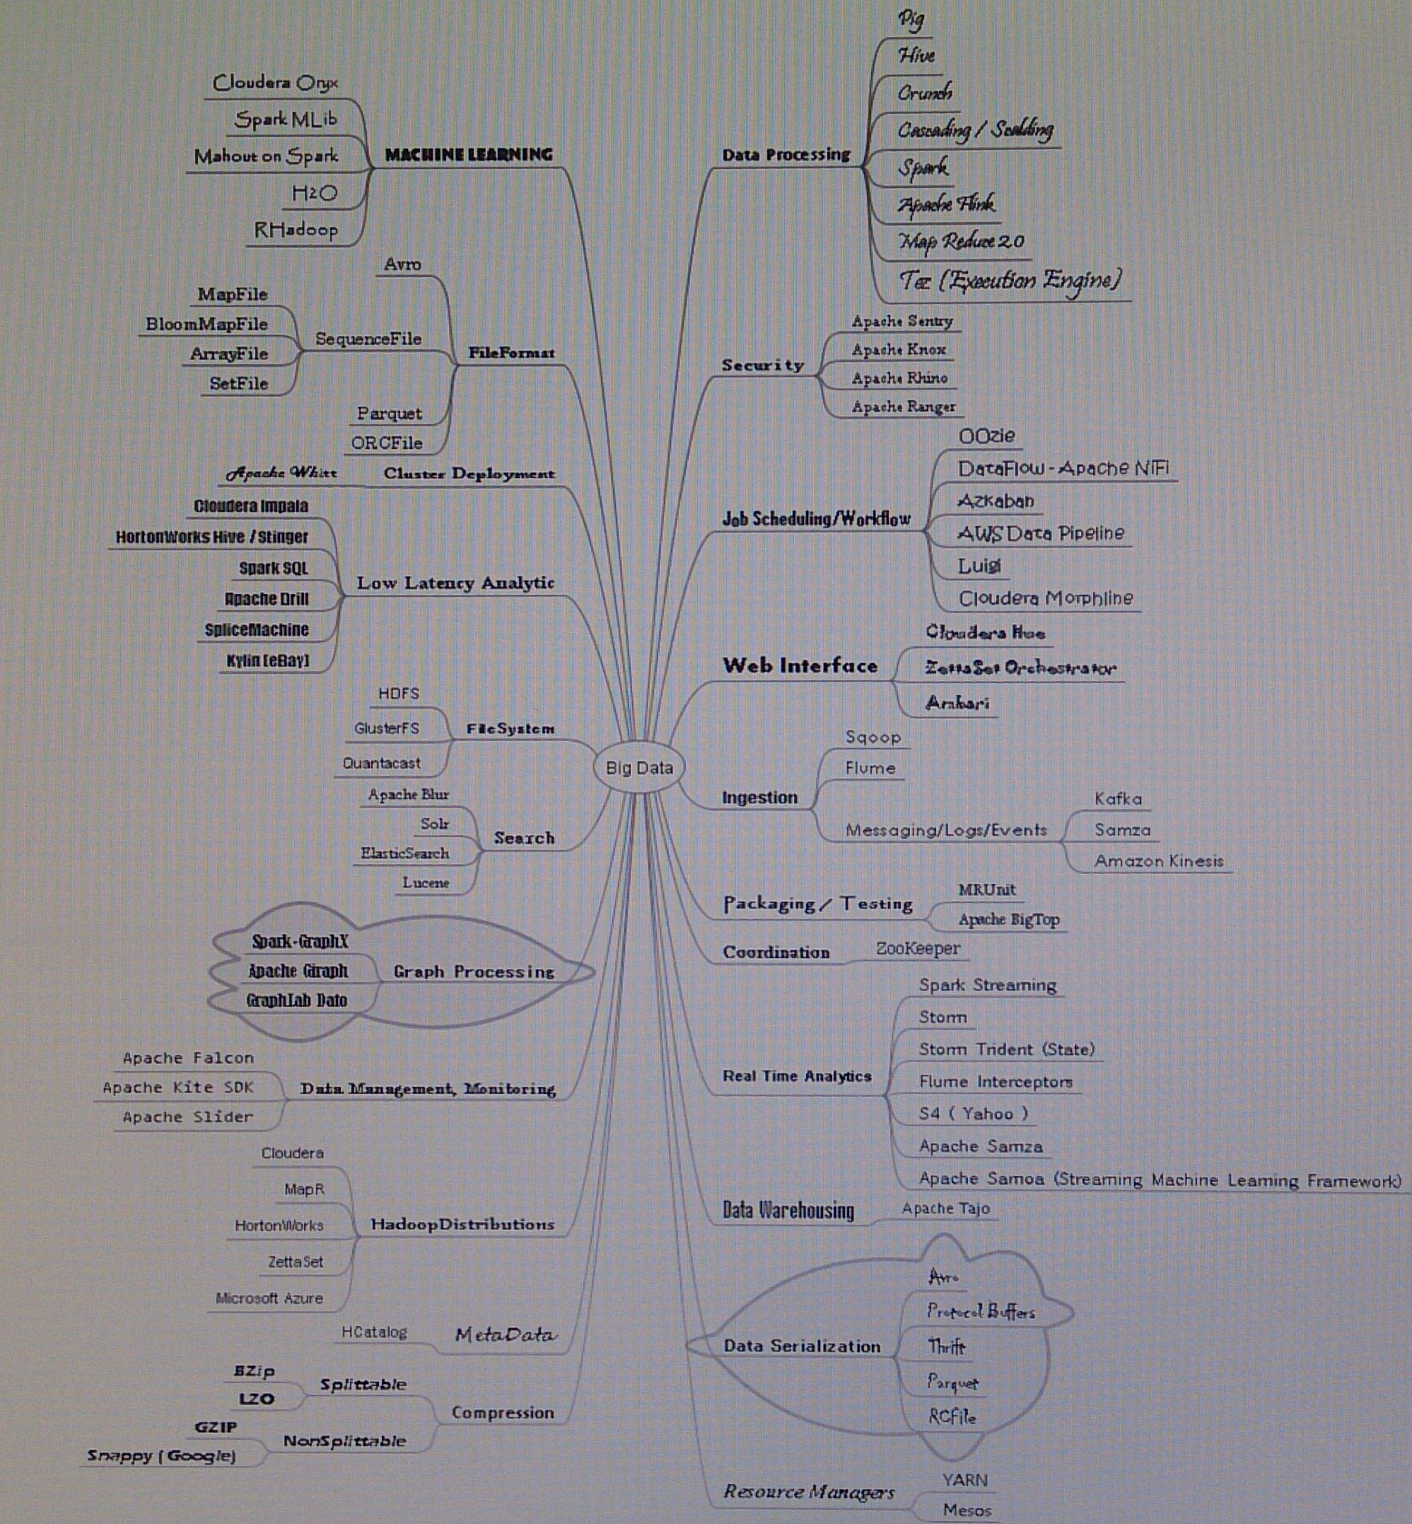
The ecosystem

Slide 13
What we would learn
Framework | Hadoop
File system | HDFS
Database | HBase, Cassandra, MongoDB
Data Processing | Pig, Hive, Spark
Ingestion and streaming | Kafka, Flume, Sqoop
Low latency analysis | Impala, SparkSQL
Job scheduling | Oozie
Real time analytics | Storm, Spark Streaming
Machine learning | Mahout, Spark MLib
Security | Ranger
File formats | Avro, Parquet
Resource manager | Yarn
Co-ordinator | Zookeeper
Search | SOLR
Metadata | HCatalog
Web Interface | Hue, Ambari
Data Warehouse | Tajo
Compression | Snappy

Slide 14
Database

Slide 15
Hbase
HBase is an open-source, non-relational, distributed database modeled after Google's Bigtable and is written in Java. It runs on top of HDFS, providing Bigtable-like capabilities for Hadoop.
It provides a fault-tolerant way of storing large quantities of sparse data (small amounts of information caught within a large collection of empty or unimportant data, such as finding the 50 largest items in a group of 2 billion records, or finding the non-zero items representing less than 0.1% of a huge collection).
HBase features compression, in-memory operation, and Bloom filters on a per-column basis as outlined in the original Bigtable paper.
In the parlance of Eric Brewer’s CAP Theorem, HBase is a CP type system

Slide 16
Hbase cont...
Tables in HBase can serve as the input and output for MapReduce jobs run in Hadoop. HBase is a column-oriented key-value data store and has been idolized widely because of its lineage with Hadoop and HDFS.
HBase runs on top of HDFS and is well-suited for faster read and write operations on large datasets with high throughput and low input/output latency.
HBase is not a direct replacement for a classic SQL database, however Apache Phoenix project provides a SQL layer for HBase as well as JDBC driver that can be integrated with various analytics and business intelligence applications.
The Apache Trafodion project provides a SQL query engine with ODBC and JDBC drivers and distributed ACID transaction protection across multiple statements, tables and rows that uses HBase as a storage engine.

Slide 17
Cassandra
Apache Cassandra is a free and open-source distributed NoSQL database management system designed to handle large amounts of data across many commodity servers, providing high availability with no single point of failure.
Cassandra offers robust support for clusters spanning multiple datacenters,with asynchronous masterless replication allowing low latency operations for all clients.
Main features
Decentralized
Supports replication and multi data center replication
Scalability
Fault-tolerant
Tunable consistency
MapReduce support
Query language

Slide 18
MongoDB
MongoDB is a free and open-source cross-platform document-oriented database program. Classified as a NoSQL database program, MongoDB uses JSON-like documents with schemas.
Main features
Ad hoc queries
Indexing
Replication
Load balancing
File storage
Aggregation
Server-side JavaScript execution
Capped collections
Transactions

Slide 19
Data Processing

Slide 20
Hive
Apache Hive is a data warehouse software project built on top of Apache Hadoop for providing data summarisation, query and analysis.
Hive gives an SQL-like interface to query data stored in various databases and file systems that integrate with Hadoop.
Hive provides the necessary SQL abstraction to integrate SQL-like queries (HiveQL) into the underlying Java without the need to implement queries in the low-level Java API.
Since most data warehousing applications work with SQL-based querying languages, Hive aids portability of SQL-based applications to Hadoop.
While initially developed by Facebook, Apache Hive is used and developed by other companies such as Netflix and the Financial Industry Regulatory Authority (FINRA).Amazon maintains a software fork of Apache Hive included in Amazon Elastic MapReduce on Amazon Web Services.

Slide 21
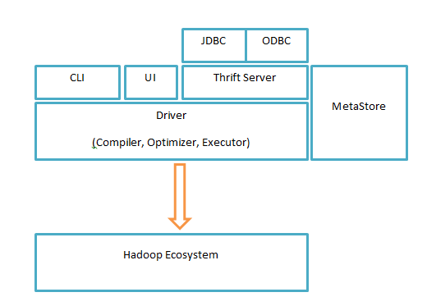
Hive cont...
Metastore: Stores metadata for each of the tables such as their schema and location.
Driver: Acts like a controller which receives the HiveQL statements.
Compiler: Performs compilation of the HiveQL query, which converts the query to an execution plan.
Optimizer: Performs various transformations on the execution plan to get an optimised DAG.
Executor: After compilation and optimisation, the executor executes the tasks.
CLI, UI, and Thrift Server: A command-line interface (CLI) provides a user interface for an external user to interact with Hive by submitting queries

Slide 22
PIG
Apache Pig is a high-level platform for creating programs that run on Apache Hadoop. The language for this platform is called Pig Latin. Pig can execute its Hadoop jobs in MapReduce.
Pig Latin abstracts the programming from the Java MapReduce idiom into a notation which makes MapReduce programming high level, similar to that of SQL for relational database management systems.
Pig Latin can be extended using user-defined functions (UDFs) which the user can write in Java, Python, JavaScript, Ruby or Groovy and then call directly from the language.

Slide 23
PIG cont...
Below is an example of a "Word Count" program in Pig Latin:
input_lines = LOAD '/tmp/my-copy-of-all-pages-on-internet' AS (line:chararray);
-- Extract words from each line and put them into a pig bag datatype, then flatten the bag to get one --word on each row
words = FOREACH input_lines GENERATE FLATTEN(TOKENIZE(line)) AS word;
-- filter out any words that are just white spaces
filtered_words = FILTER words BY word MATCHES '\\w+';
-- create a group for each word
word_groups = GROUP filtered_words BY word;
-- count the entries in each group
word_count = FOREACH word_groups GENERATE COUNT(filtered_words) AS count, group AS word;
-- order the records by count
ordered_word_count = ORDER word_count BY count DESC;
STORE ordered_word_count INTO '/tmp/number-of-words-on-internet';

Slide 24
Spark
Apache Spark is an open-source cluster-computing framework
Apache Spark has as its architectural foundation the resilient distributed dataset (RDD), a read-only multiset of data items distributed over a cluster of machines, that is maintained in a fault-tolerant way
Spark facilitates the implementation of both iterative algorithms, that visit their data set multiple times in a loop, and interactive/exploratory data analysis, i.e., the repeated database-style querying of data
Apache Spark requires a cluster manager and a distributed storage system
A DataFrame is a Dataset organized into named columns. It is conceptually equivalent to a table in a relational database or a data frame in R/Python, but with richer optimizations under the hood
DataFrames can be constructed from a wide array of sources such as: structured data files, tables in Hive, external databases, or existing RDDs.

Slide 25
Spark cont...
from pyspark.sql import SparkSession
spark = SparkSession.builder.appName("Python Spark SQL basic example").config("spark.some.config.option", "some-value").getOrCreate()
# spark is an existing SparkSession df = spark.read.json("examples/src/main/resources/people.json") # Displays the content of the DataFrame to stdout df.show() # +----+-------+ # | age| name| # +----+-------+ # |null|Michael| # | 30| Andy| # | 19| Justin| # +----+-------+ | # Count people by age df.groupBy("age").count().show() # +----+-----+ # | age|count| # +----+-----+ # | 19| 1| # |null| 1| # | 30| 1| # +----+-----+

Slide 26
Ingestion and Streaming

Slide 27
KAFKA
Apache Kafka is a distributed streaming platform.
A streaming platform has three key capabilities:
Publish and subscribe to streams of records, similar to a message queue or enterprise messaging system.
Store streams of records in a fault-tolerant durable way.
Process streams of records as they occur.
Kafka is generally used for two broad classes of applications:
Building real-time streaming data pipelines that reliably get data between systems or applications
Building real-time streaming applications that transform or react to the streams of data
First a few concepts:
Kafka is run as a cluster on one or more servers that can span multiple datacenters.
The Kafka cluster stores streams of records in categories called topics.
Each record consists of a key, a value, and a timestamp.

Slide 28
Kafka core API
The Producer API allows an application to publish a stream of records to one or more Kafka topics.
The Consumer API allows an application to subscribe to one or more topics and process the stream of records produced to them.
The Streams API allows an application to act as a stream processor, consuming an input stream from one or more topics and producing an output stream to one or more output topics, effectively transforming the input streams to output streams.
The Connector API allows building and running reusable producers or consumers that connect Kafka topics to existing applications or data systems. For example, a connector to a relational database might capture every change to a table.

Slide 29
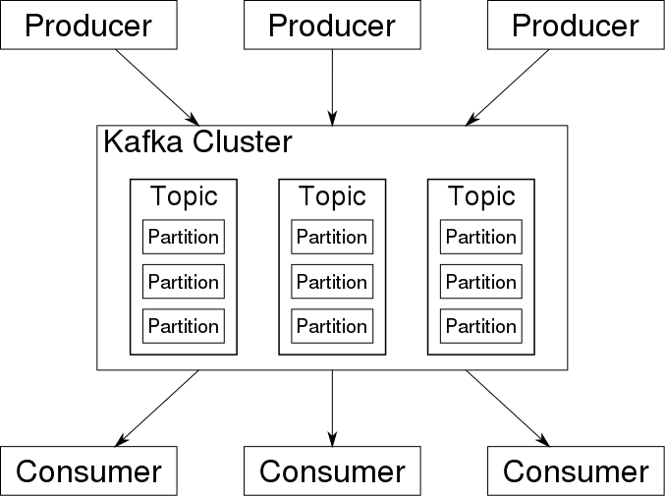
Kafka architecture

Slide 30
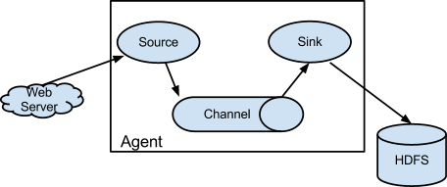
FLUME
Flume is a distributed, reliable, and available service for efficiently collecting, aggregating, and moving large amounts of log data.
It has a simple and flexible architecture based on streaming data flows. It is robust and fault tolerant with tunable reliability mechanisms and many failover and recovery mechanisms.
It uses a simple extensible data model that allows for online analytic application.

Slide 31
Kafka vs Flume
Flume and Kafka both can act as the event backbone for real-time event processing. Some features are overlapping between the two and there are some confusions about what should be used in what use cases.
Compared to Flume, Kafka wins on the its superb scalability and message durability.
Kafka is very scalable
Kafka's scalability is also demonstrated by its ability to handle spike of the events
Kafka supports both synchronous and asynchronous replication
Notes:
1)
Kafka is very scalable. One of the key benefits of Kafka is that it is very easy to add large number of consumers without affecting performance and without down time. That's because Kafka does not track which messages in the topic have been consumed by consumers. It simply keeps all messages in the topic within a configurable period. It is the consumers' responsibility to do the tracking through offset.
In contrast, adding more consumers to Flume means changing the topology of Flume pipeline design, replicating the channel to deliver the messages to a new sink. It is not really a scalable solution when you have huge number of consumers. Also since the flume topology needs to be changed, it requires some down time.
2)
Kafka's scalability is also demonstrated by its ability to handle spike of the events. This is where Kakfa truly shines because it acts as a "shock absorber" between the producers and consumers. Kafka can handle events at 100k+ per second rate coming from producers. Because Kafka consumers pull data from the topic, different consumers can consume the messages at different pace.
Flume sink supports push model. When event producers suddenly generate a flood of messages, even though flume channel somewhat acts as a buffer between source and sink, the sink endpoints might still be overwhelmed by the write operations.
3)
Kafka supports both synchronous and asynchronous replication based on your durability requirement and it uses commodity hard drive.
Flume supports both ephemeral memory-based channel and durable file-based channel. Even when you use a durable file-based channel, any event stored in a channel not yet written to a sink will be unavailable until the agent is recovered. Moreoever, the file-based channel does not replicate event data to a different node. It totally depends on the durability of the storage it writes upon.
4)
If you use Kafka, most likely you have to write your own producer and consumer. Of course, as Kakfa becomes more and more popular, other frameworks are constantly adding integration support for Kafka.
Flume does have some features that makes it attractive to be a data ingestion and simple event processing framework. The key benefit of Flume is that it supports many built-in sources and sinks, which you can use out of box.

Slide 32
Sqoop
Apache Sqoop is a tool designed for efficiently transferring bulk data between Apache Hadoop and structured datastores such as relational databases.
Sqoop supports incremental loads of a single table or a free form SQL query as well as saved jobs which can be run multiple times to import updates made to a database since the last import.
Imports can also be used to populate tables in Hive or HBase. Exports can be used to put data from Hadoop into a relational database.
Sqoop got the name from sql+hadoop.

Slide 33
Low Latency Analytics

Slide 34
Impala
Massively parallel processing (MPP) SQL query engine for data stored in Apache Hadoop
Enables users to issue low-latency SQL queries to data stored in HDFS and Apache HBase without requiring data movement or transformation
Impala is integrated with Hadoop to use the same file and data formats, metadata, security and resource management frameworks used by MapReduce, Apache Hive, Apache Pig
Features include:
Supports HDFS and Apache HBase storage,
Reads Hadoop file formats, including text, LZO, SequenceFile, Avro, RCFile, and Parquet,
Supports Hadoop security (Kerberos authentication),
Fine-grained, role-based authorization with Apache Sentry,
Uses metadata, ODBC driver, and SQL syntax from Apache Hive.

Slide 35
Spark SQL
Spark SQL is Apache Spark's module for working with structured data.
Spark SQL lets you query structured data inside Spark programs, using either SQL or a familiar DataFrame API. Usable in Java, Scala, Python and R.
DataFrames and SQL provide a common way to access a variety of data sources.
Spark SQL supports HiveQL.
A server mode provides industry standard JDBC and ODBC connectivity for business intelligence tools.
Spark SQL includes a cost-based optimizer, columnar storage and code generation to make queries fast.
At the same time, it scales to thousands of nodes and multi hour queries using the Spark engine, which provides full mid-query fault tolerance.
Spark SQL is developed as part of Apache Spark. It thus gets tested and updated with each Spark release.

Slide 36
Job Scheduling : Oozie
Oozie is a workflow scheduler system to manage Apache Hadoop jobs.
Oozie Workflow jobs are Directed Acyclical Graphs (DAGs) of actions.
Oozie Coordinator jobs are recurrent Oozie Workflow jobs triggered by time (frequency) and data availability.
Oozie is integrated with the rest of the Hadoop stack supporting several types of Hadoop jobs out of the box (such as Java map-reduce, Streaming map-reduce, Pig, Hive, Sqoop and Distcp) as well as system specific jobs (such as Java programs and shell scripts).
Oozie is a scalable, reliable and extensible system.

Slide 37
Real Time Analytics

Slide 38
Storm
Apache Storm is a distributed stream processing computation framework written predominantly in the Clojure programming language.
It uses custom created "spouts" and "bolts" to define information sources and manipulations to allow batch, distributed processing of streaming data.
Storm has many use cases: realtime analytics, online machine learning, continuous computation, distributed RPC, ETL, and more. Storm is fast: a benchmark clocked it at over a million tuples processed per second per node. It is scalable, fault-tolerant, guarantees your data will be processed, and is easy to set up and operate.

Slide 39
Storm components
Apache Storm cluster comprises following critical components:
Nodes- There are two types of nodes, i.e., Master Node and Worker Node. The Master Node executes a daemon Nimbus which assigns tasks to machines and monitors their performances. On the other hand, the Worker Node runs the daemon called Supervisor which assigns the tasks to other worker node and operates them as per the need. As Storm cannot monitor the state and health of cluster, it deploys ZooKeeper to solve this issue which connects Nimbus with the Supervisors.
Components- Storm has three critical components, viz., Topology, Stream, and Spout. Topology is a network made of Stream and Spout. Stream is an unbounded pipeline of tuples and Spout is the source of the data streams which converts the data into the tuple of streams and sends to the bolts to be processed.

Slide 40
Spark Streaming
Spark Streaming is an extension of the core Spark API that enables scalable, high-throughput, fault-tolerant stream processing of live data streams.
Data can be ingested from many sources like Kafka, Flume, Kinesis, or TCP sockets, and can be processed using complex algorithms expressed with high-level functions like map, reduce, join and window.
Finally, processed data can be pushed out to filesystems, databases, and live dashboards. In fact, you can apply Spark’s machine learning and graph processing algorithms on data streams.
Spark Streaming receives live input data streams and divides the data into batches, which are then processed by the Spark engine to generate the final stream of results in batches.

Slide 41
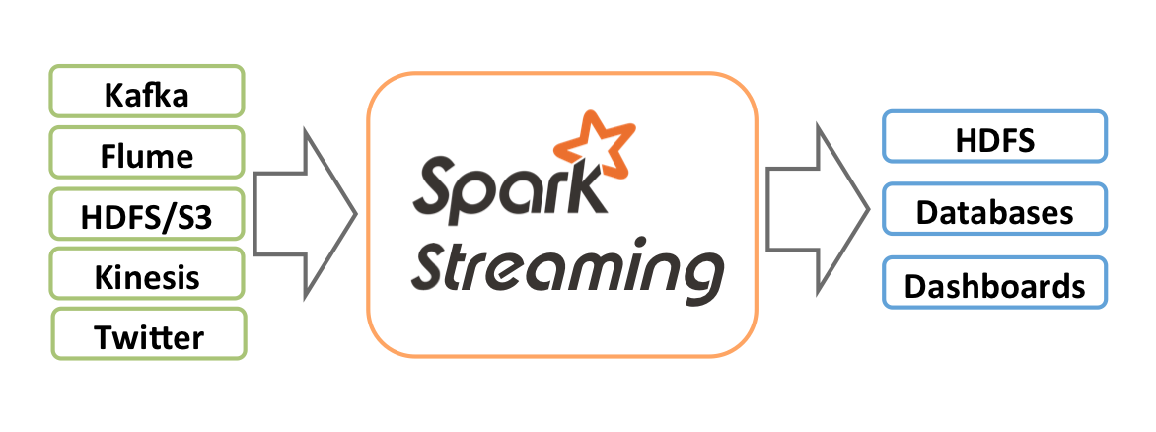
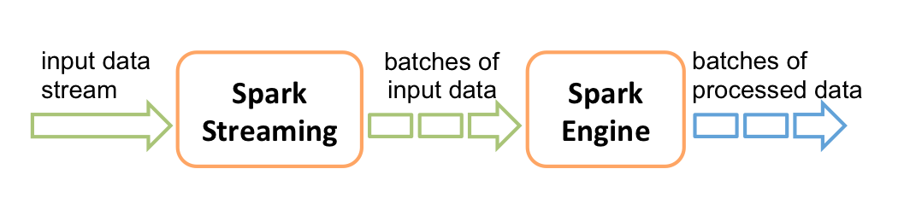
Spark architecture

Slide 42
An example
from pyspark import SparkContext
from pyspark.streaming import StreamingContext
# Create a local StreamingContext with two working thread and batch interval of 1 second
sc = SparkContext("local[2]", "NetworkWordCount")
ssc = StreamingContext(sc, 1)
lines = ssc.socketTextStream("localhost", 9999) # Create a DStream that will connect to hostname:port, like localhost:9999
words = lines.flatMap(lambda line: line.split(" ")) # Split each line into words
pairs = words.map(lambda word: (word, 1)) # Count each word in each batch
wordCounts = pairs.reduceByKey(lambda x, y: x + y)
wordCounts.pprint() # Print the first ten elements of each RDD generated in this DStream to the console
ssc.start() # Start the computation
ssc.awaitTermination() # Wait for the computation to terminate
Run the below on new shell:
$ nc -lk 9999
Start the stream consumption:
$ ./bin/spark-submit examples/src/main/python/streaming/network_wordcount.py localhost 9999

Slide 43
Machine Learning

Slide 44
Mahout
Apache Mahout is a project of the Apache Software Foundation to produce free implementations of distributed or otherwise scalable machine learning algorithms focused primarily in the areas of collaborative filtering, clustering and classification.
Mahout also provides Java libraries for common maths operations (focused on linear algebra and statistics) and primitive Java collections.
Mahout was originally a separate project and can run stand-alone without Hadoop.

Slide 45
Spark MLib
MLlib is Apache Spark's scalable machine learning library.
MLlib fits into Spark's APIs and interoperates with NumPy in Python (as of Spark 0.9) and R libraries (as of Spark 1.5). You can use any Hadoop data source (e.g. HDFS, HBase, or local files), making it easy to plug into Hadoop workflows.
Spark excels at iterative computation, enabling MLlib to run fast. At the same time, we care about algorithmic performance: MLlib contains high-quality algorithms that leverage iteration, and can yield better results than the one-pass approximations sometimes used on MapReduce.
You can run Spark using its standalone cluster mode, on EC2, on Hadoop YARN, on Mesos, or on Kubernetes. Access data in HDFS, Apache Cassandra, Apache HBase, Apache Hive, and hundreds of other data sources.

Slide 46
Spark MLib cont...
ML algorithms include: Classification: logistic regression, naive Bayes,... Regression: generalized linear regression, survival regression,... Decision trees, random forests, and gradient-boosted trees Recommendation: alternating least squares (ALS) Clustering: K-means, Gaussian mixtures (GMMs),... Topic modeling: latent Dirichlet allocation (LDA) Frequent itemsets, association rules, and sequential pattern mining | ML workflow utilities include: Feature transformations: standardization, normalization, hashing,... ML Pipeline construction Model evaluation and hyper-parameter tuning ML persistence: saving and loading models and Pipelines

Slide 47
Security : Ranger
Apache Range is a framework to enable, monitor and manage comprehensive data security across the Hadoop platform.
The vision with Ranger is to provide comprehensive security across the Apache Hadoop ecosystem. With the advent of Apache YARN, the Hadoop platform can now support a true data lake architecture. Enterprises can potentially run multiple workloads, in a multi tenant environment.
Data security within Hadoop needs to evolve to support multiple use cases for data access, while also providing a framework for central administration of security policies and monitoring of user access.

Slide 48
Security : Ranger cont...
row-level filters
restrict users to access subset of rows based on group the user belongs to
restrict users to access subset of rows based on data in another table
restrict users to access subset of rows based on data in reference tables
allow specific users/groups to access all rows
data-masking
only part of a particular column should be shown
whole column value should not be shown
apply a custom transformation to the column

Slide 49
File Formats : Avro & Parquet
Avro
Widely used as a serialization platform
Row-based, offers a compact and fast binary format
Schema is encoded on the file so the data can be untagged
Files support block compression and are splittable
Supports schema evolution
Parquet
Column-oriented binary file format
Uses the record shredding and assembly algorithm described in the Dremel paper
Each data file contains the values for a set of rows
Efficient in terms of disk I/O when specific columns need to be queried

Slide 50
Resource Manager : Yarn
Apache Hadoop YARN is the resource management and job scheduling technology in the open source Hadoop distributed processing framework.
One of Apache Hadoop's core components, YARN is responsible for allocating system resources to the various applications running in a Hadoop cluster and scheduling tasks to be executed on different cluster nodes.
YARN stands for Yet Another Resource Negotiator
The ResourceManager and the NodeManager form the data-computation framework. The ResourceManager is the ultimate authority that arbitrates resources among all the applications in the system. The NodeManager is the per-machine framework agent who is responsible for containers, monitoring their resource usage (cpu, memory, disk, network) and reporting the same to the ResourceManager/Scheduler.

Slide 51
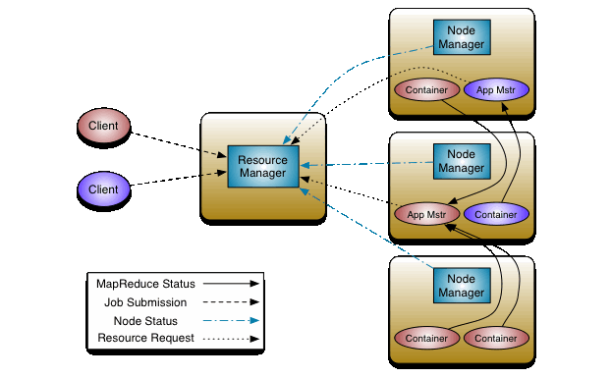
Yarn architecture
The ResourceManager and the NodeManager form the data-computation framework.
The ResourceManager is the ultimate authority that arbitrates resources among all the applications in the system.
The NodeManager is the per-machine framework agent who is responsible for containers, monitoring their resource usage (cpu, memory, disk, network) and reporting the same to the ResourceManager/Scheduler.

Slide 52
Co-ordination : Zookeeper
Apache ZooKeeper is essentially a centralized service for distributed systems to a hierarchical key-value store, which is used to provide a distributed configuration service, synchronization service, and naming registry for large distributed systems
ZooKeeper's architecture supports high availability through redundant services. The clients can thus ask another ZooKeeper leader if the first fails to answer.
ZooKeeper nodes store their data in a hierarchical name space, much like a file system or a tree data structure. Clients can read from and write to the nodes and in this way have a shared configuration service.
ZooKeeper can be viewed as an atomic broadcast system, through which updates are totally ordered. The ZooKeeper Atomic Broadcast (ZAB) protocol is the core of the system

Slide 53
Zookeeper architecture
The basic terminologies that you need to know before knowing the architecture are:
Node: The systems installed on the cluster
ZNode: The nodes where the status is updated by other nodes in cluster
Client Applications: The tools that interact with the distributed applications
Server Applications: Allows the client applications to interact using a common interface
The services in the cluster are replicated and stored on a set of servers (called an "ensemble"), each of which maintains an in-memory database containing the entire data tree of state as well as a transaction log and snapshots stored persistently.
Multiple client applications can connect to a server, and each client maintains a TCP connection through which it sends requests and heartbeats and receives responses and watch events for monitoring

Slide 54
Search : SOLR
Solr is highly reliable, scalable and fault tolerant, providing distributed indexing, replication and load-balanced querying, automated failover and recovery, centralized configuration and more.
Solr powers the search and navigation features of many of the world's largest internet sites.
Features of Solr:
Advanced Full-Text Search Capabilities
Optimized for High Volume Traffic
Standards Based Open Interfaces - XML, JSON and HTTP
Comprehensive Administration Interfaces
Easy Monitoring
Highly Scalable and Fault Tolerant
Flexible and Adaptable with easy configuration
Near Real-Time Indexing
Extensible Plugin Architecture

Slide 55
Metadata : HCatalog
HCatalog is a table and storage management layer for Hadoop that enables users with different data processing tools — Pig, MapReduce — to more easily read and write data on the grid.
Itis a table storage management tool for Hadoop that exposes the tabular data of Hive metastore to other Hadoop applications. It enables users with different data processing tools (Pig, MapReduce) to easily write data onto a grid.
HCatalog ensures that users don’t have to worry about where or in what format their data is stored.

Slide 56
Web Interface : Hue & Ambari
Hue is an open source Analytics Workbench for browsing, querying and visualizing data.
Applications
Editors for Hive, Impala, Pig, MapReduce, Spark and any SQL like MySQL, Oracle, SparkSQL, Solr SQL, Phoenix and more.
Dashboards to dynamically interact and visualize data with Solr or SQL.
Scheduler of jobs and workflows.
Browsers for Jobs, HDFS, S3 files, SQL Tables, Indexes, Git files, Sentry permissions, Sqoop and more.
Ambari is aimed at making Hadoop management simpler by developing software for provisioning, managing, and monitoring Apache Hadoop clusters.
Ambari enables System Administrators to:
Provision a Hadoop Cluster
Manage a Hadoop Cluster
Ambari provides central management for starting, stopping, and reconfiguring Hadoop services across the entire cluster.
Monitor a Hadoop Cluster

Slide 57
Data Warehousing : Tajo
Apache Tajo is a relational and distributed data processing framework. It is designed for low latency and scalable ad-hoc query analysis.
Tajo supports standard SQL and various data formats. Most of the Tajo queries can be executed without any modification.
Tajo has fault-tolerance through a restart mechanism for failed tasks and extensible query rewrite engine.
Tajo performs the necessary ETL (Extract Transform and Load process) operations to summarize large datasets stored on HDFS. It is an alternative choice to Hive/Pig.

Slide 58
Compression : Snappy
Snappy (previously known as Zippy) is a fast data compression and decompression library written in C++ by Google based on ideas from LZ77
Snappy is widely used in Google projects like Bigtable, MapReduce and in compression data in Google's internal RPC systems.
It can be used in open-source projects like MariaDB ColumnStore, Cassandra, Hadoop, LevelDB, MongoDB, RocksDB, Lucene.

